Slide 1
Food Delivery System
Presented by
AKONGA MANUEL
MEPONG ALEXANDRE
FOIN ROONEY
EWANE JONATHAN

Slide 2
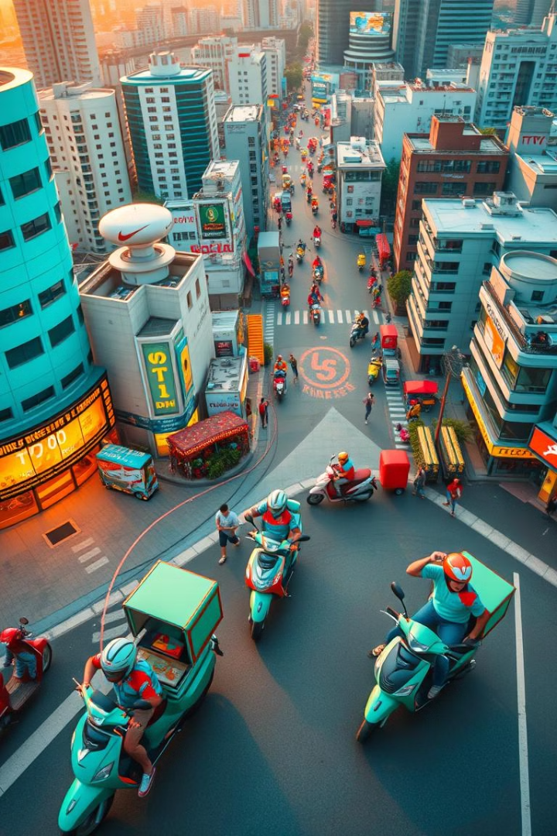
Food Delivery System: Uber Eats Style
Exploring the architecture of a food delivery system like Uber Eats, using diagrams to visualize core concepts.

Slide 3
Use Case Diagram
Actors
Use Cases
Customer - Places orders, views menus, tracks orders.
Place Order - Customer places an order for food.
Restaurant - Manages menu, accepts orders, prepares food.
View Menu - Customer browses a restaurant's menu.
Track Order - Customer monitors the status of their order.
Delivery Driver - Accepts orders, delivers food, manages routes.
Accept Order - Driver agrees to pick up and deliver an order.
Admin - Manages system settings, monitors orders, tracks drivers.
Deliver Food - Driver delivers the food to the customer.
Manage Menu - Restaurant updates menu items and pricing.

Slide 4
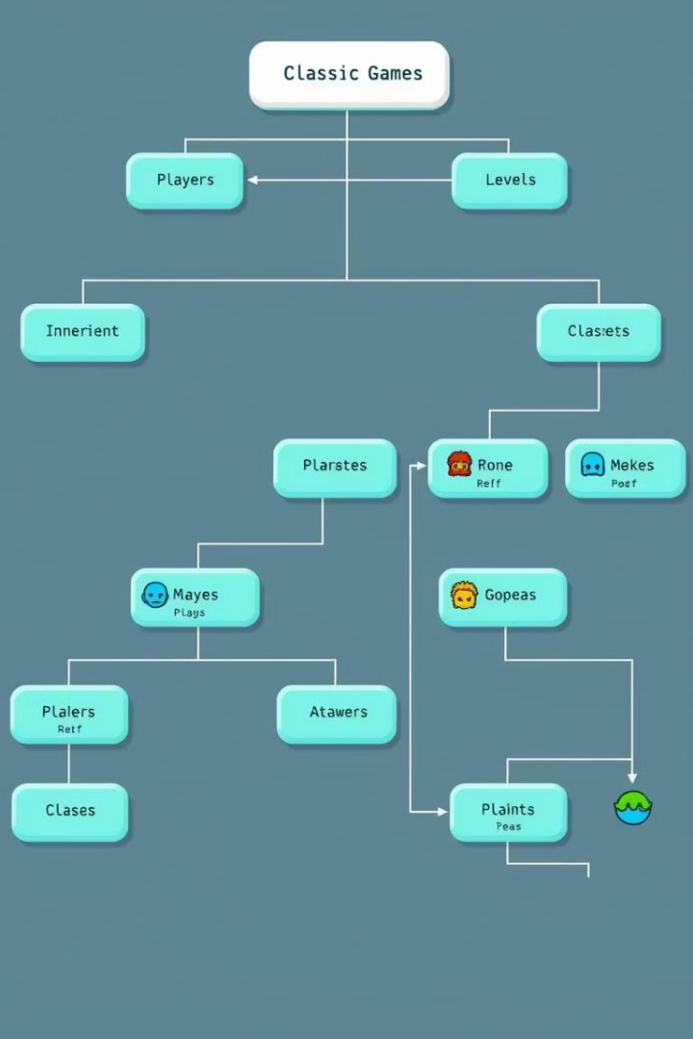
Class Diagram
Customer
Restaurant
Name, Address, Phone Number, Order History
Name, Address, Menu, Open Hours, Order Status
Delivery Driver
Order
Name, Location, Vehicle Type, Order Assignment
Customer, Restaurant, Items, Price, Delivery Time

Slide 5
State Transition Diagram
1
Order Placed
Order is created and sent to the restaurant.
2
Order Accepted
Restaurant confirms the order and begins preparation.
3
Order Ready
Restaurant finishes preparing the order and awaits driver pick up.
4
Order Assigned
A delivery driver accepts the order.
5
Order Out for Delivery
Driver picks up the order and begins delivery.
6
Order Delivered
Driver delivers the order to the customer.
7
Order Completed
Order is finished and marked as complete.

Slide 6
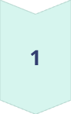
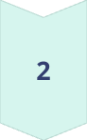
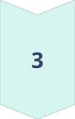
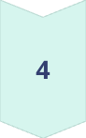
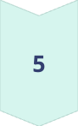
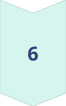
Activity Diagram
Customer Places Order
Customer selects items, enters address, and submits order.
Restaurant Receives Order
Restaurant confirms order and begins preparing food.
Driver Accepts Order
Driver accepts the order and begins route planning.
Driver Picks Up Order
Driver arrives at the restaurant and picks up the order.
Driver Delivers Order
Driver delivers the order to the customer's address.
Customer Receives Order
Customer receives the order and confirms delivery.

Slide 7
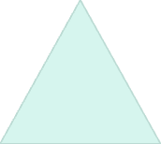
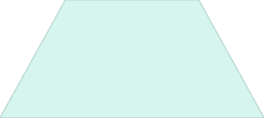
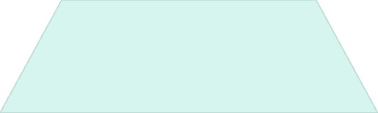
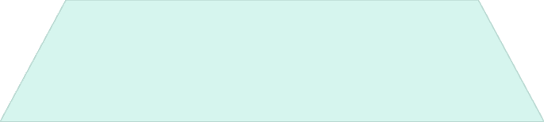
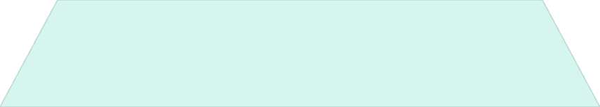
Sequence Diagram
Customer
1
Places Order
System
2
Sends Order to Restaurant
Restaurant
3
Accepts Order, Prepares Food
System
4
Notifies Driver
Driver
5
Accepts Order, Picks Up Food, Delivers Order

Slide 8
Component Diagram
User Interface
1
Web or mobile app for users to place orders, view menus, track deliveries.
Order Management System
2
Handles order processing, payment processing, and order status updates.
Restaurant Management System
3
Allows restaurants to manage menus, accept orders, and track order statuses.
Delivery Driver App
4
Provides drivers with order assignments, navigation, and communication features.

Slide 9

Key Takeaways
3
2
Key Components
Core Functions
User interface, order management, restaurant management, driver app.
Order placement, delivery, payment processing.
1
Key Actors
Customers, restaurants, delivery drivers, system administrators.

Slide 10
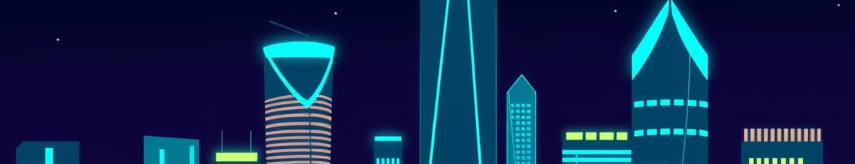
Conclusion
This overview of a food delivery system provides a solid foundation for understanding its key components, functions, and actors. This architecture can be tailored and expanded to meet the specific needs of any food delivery platform.

